Slide 1


Smart Home Automation:
Presented By:
P Sanjana Reddy(21251A3622)
N.Sethu(21251A3650)
S Likhitha Goud(22255A3601)

Slide 2
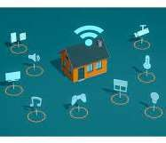
INTRODUCTION
A smart home system powered by the Internet of Things
(IoT).
It allows homeowners to remotely control and automate various household devices and systems, such as lighting, heating, security, and entertainment, through a central platform.
This technology enables users to optimize energy consumption, increase convenience, and enhance security and comfort levels in their homes.

Slide 3

IMPORTANCE
The importance of Smart Home Systems by IoT lies in
the convenience, efficiency, and security they provide.
IoT-enabled devices allow users to control their homes remotely, save energy and money, and monitor their security systems from anywhere.
Additionally, these systems offer increased accessibility and independence for individuals with disabilities or limited mobility.

Slide 4
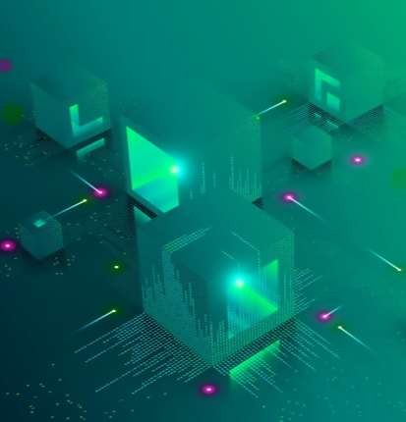
WORKING OF SMART HOME SYSTEMS BY IOT
Smart home systems use IoT sensors and devices to collect data on the home's environment and the behavior of its occupants.
This data is processed and analyzed by the smart home system to identify patterns and make predictions about user preferences and behavior.
Based on this analysis, the smart home system can automate various functions such as adjusting the temperature, turning on/off lights, and even making decisions about security and energy consumption.

Slide 5

ARDUINO IDE:
Arduino is an open-source electronics platform based on easy-to-use hardware and software. It consists of a microcontroller board, a software development environment, and a community of users and developers. Arduino boards are designed to be easy to use for both beginners and experts in electronics and programming.
To install the Arduino IDE, follow these steps:
Go to the Arduino website at https://www.arduino.cc/ and click on the "Software" tab.
Choose your operating system from the list of options.
Click on the "Download" button to download the installer file.
Once the download is complete, double-click on the installer file to begin the installation process.
Follow the on-screen instructions to install the Arduino IDE on your computer.
Once the installation is complete, you can launch the Arduino IDE and begin programming your Arduino board.

Slide 6







IOT SENSORS & DEVICES USED IN SMART HOME SYSTEMS
IoT sensors and devices used in smart home systems can include motion sensors, temperature sensors, light sensors, and door/window sensors.
Smart home systems may also include IoT devices such as smart thermostats, smart locks, smart lighting, and smart entertainment systems.
These sensors and devices are often connected to a central hub or app, allowing users to control and monitor their home's environment remotely.

Slide 7

BLYNK:
Blynk is a mobile app platform that allows you to control Internet of Things (IoT) devices remotely through a simple, user-friendly interface. With Blynk, you can create a custom mobile app for your IoT project without having to write any code.
Here's how Blynk works in IoT projects:
Install the Blynk app on your mobile device and create a new project.
Choose the type of hardware you will be using for your project (such as an Arduino or Raspberry Pi).
Use the Blynk app to generate a unique authentication token for your hardware device.
Use the Blynk library in your hardware project code to connect to the Blynk server and authenticate your device with the token.
In the Blynk app, add user interface widgets (such as buttons, sliders, and displays) to control and monitor your IoT device.
Use the Blynk library in your hardware project code to read input from the user interface widgets and control your IoT device accordingly.

Slide 8




FEATURES OF SMART HOME SYSTEMS BY IOT
Remote monitoring and control of various home functions, such as temperature, lighting, and security.
Automated responses to environmental changes or user behavior, such as adjusting the temperature or turning on/off lights.
Integration with voice assistants and mobile apps for easy control and customization.
Analytics and insights into energy consumption and user behavior to optimize efficiency and improve user experience.

Slide 9
Amazon Echo/Alexa: A popular smart home system that allows users to control various functions such as lighting, temperature, and entertainment with voice commands. It also integrates with other IoT devices such as smart locks and security cameras.
EXAMPLES OF SMART HOME SYSTEMS BY IOT
Nest: A smart thermostat system that learns users' behavior and preferences to automatically adjust the temperature and save energy. It can also be controlled remotely via a mobile app.
Philips Hue: A smart lighting system that allows users to control the color and brightness of their lights with a mobile app or voice commands. It can also be programmed to turn on/off at specific times or in response to other IoT sensors.
Ring: A smart security system that includes video doorbells, security cameras, and smart locks. It allows users to monitor and control their home's security remotely via a mobile app.

Slide 10

Challenges and risks of Smart Home Systems by IoT
Security and privacy risks due to the potential for hackers to access and
control IoT devices.
Interoperability issues between different IoT devices and platforms, making it difficult for users to integrate and control multiple devices from a single interface.
Reliability concerns, as IoT devices and sensors can sometimes
malfunction or fail, leading to disruptions or incorrect data.
Maintenance and upgrading of IoT devices can be costly and time- consuming, leading to issues with compatibility and obsolescence.

Slide 11




Best practices for implementing Smart Home Systems by IoT
Conduct a thorough risk assessment of the smart home system to identify potential security and privacy risks and develop strategies to mitigate them.
Choose IoT devices and platforms that are compatible and interoperable with each other and ensure that they are regularly updated and maintained.
Implement strong authentication and encryption measures to protect user data and prevent unauthorized access to IoT devices.
Provide clear and transparent privacy policies and user agreements that inform users about how their data will be collected, used, and shared.

Slide 12



Future outlook and potential for further advancements in IoT technology
The IoT market is expected to continue growing rapidly, with an estimated 41 billion
IoT devices in use by 2027.
Advancements in AI and machine learning are expected to enable more sophisticated
data analytics and automation capabilities in IoT systems.
5G networks will offer faster and more reliable connectivity for IoT devices, enabling
new applications and use cases such as smart cities and autonomous vehicles.
The integration of blockchain technology with IoT systems is expected to enhance
security, privacy, and data sharing capabilities.

Slide 13

THANK YOU

